Slide 1
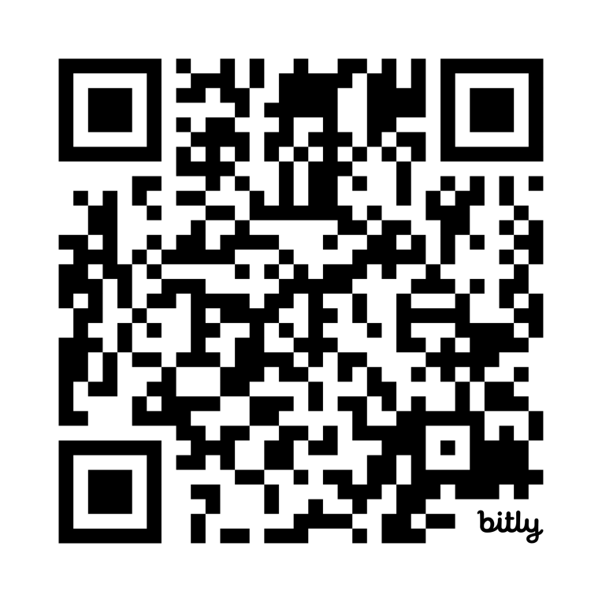

Agile Project Monitoring and Control Quiz
https://bit.ly/4521XE1

